Slide 1
DataVerse Data visualization for Finance
Group 6
Aadarsha Chapagain (C0825975)
Rajasekhar katta (C0833766)
Venkata sai manikanta Ponakala (c0833772)
Rishi Phaneendra Varma Bhupathi Raju(C0825285)

Slide 2
Contents
Project Title and Description
What is DataVerse ?
Project Team
Business Case
Credit card spending Visualisation
Technology & Resource
Key Stakeholder List
Stakeholder Requirements as known
Product Description

Slide 3
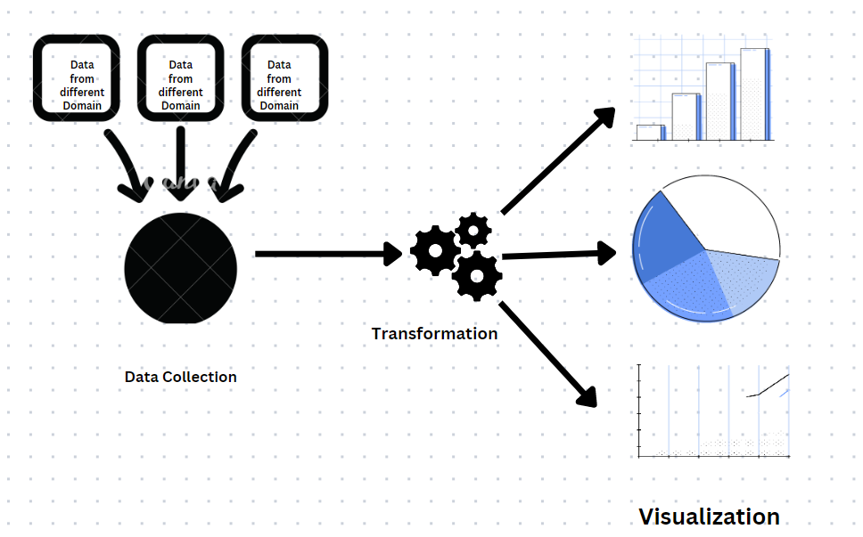
What is DataVerse

Slide 4
Project Title and description
Financial institutions are struggling to get insights from their data
Excel is not enough to handle huge amount of data
Just Accumulating data won’t add any value to organization
Companies utilizing data as an information assets are ahead of the game
Dataverse is a data visualization project where data from financial institutions will be collected, transformed and visualized

Slide 5
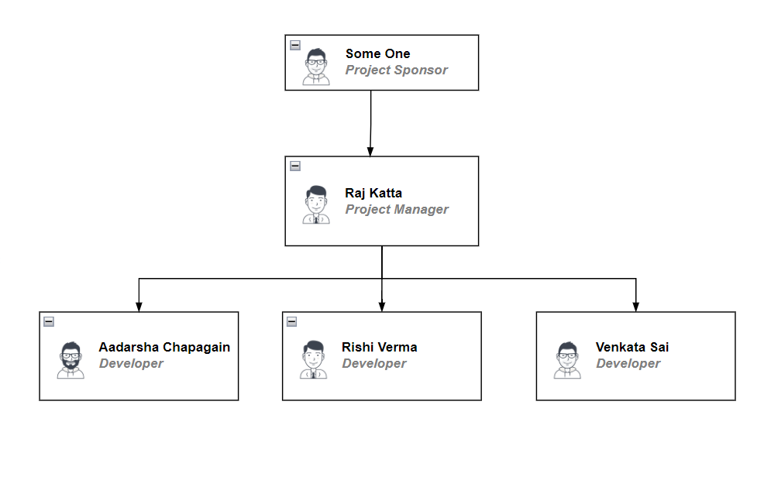
Project Team

Slide 6
Business Case
This project targets banking customers when and how they are likely to be most amenable to making a purchase.
This provides information to help optimize banking marketing efforts. This knowledge can involve anything. Client may design a new product or service and know when and where to market them.
Additionally, if a client experiencing a slowdown in sales, the data will provide insights into what is wrong.

Slide 7
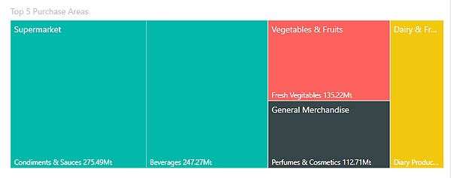
Credit card spending Visualisation

Slide 8
Technology & Resource
This project leverages Microsoft Azure Public Cloud services as Pay-as-you-Go subscription to avoid capital investments and operational maintenance.
Rajasekhar katta will be the Project Manager and Data modeler.
Rishi Varma will be appointed as Data Engineer.
Aadarsha Chapagain will be an Azure Devops developer.
Venkata Sai Manikanta will be PowerBI developer.

Slide 9
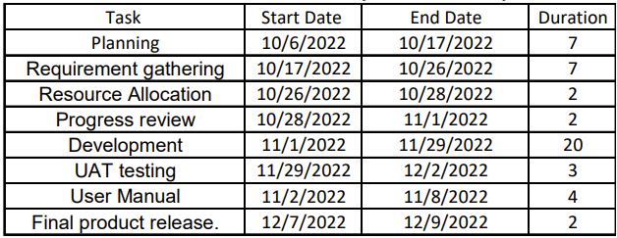
WBS

Slide 10
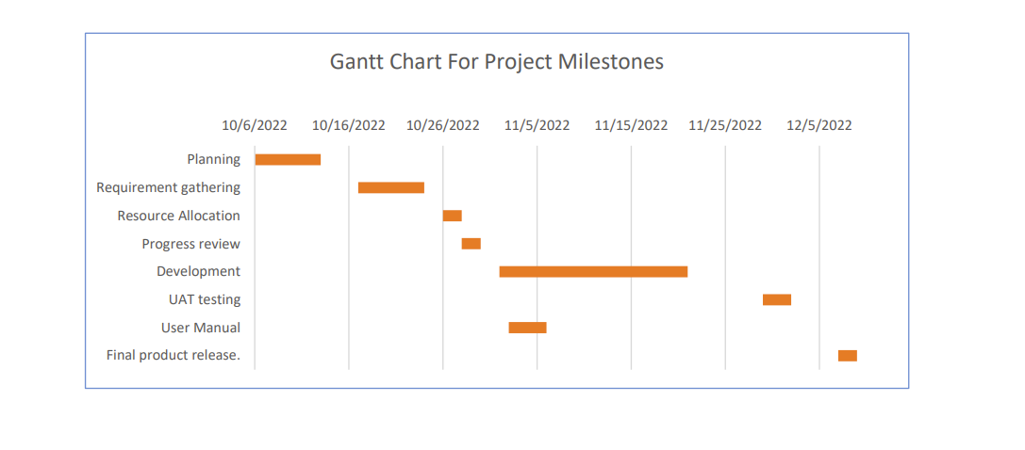
WBS contd.

Slide 11
Key Stakeholder List
Customers
Project Manager
Project Team Members
Company Executives
Project Sponsor
Steering Committee
An Advisory group providing guidance on key decision's on sponsor, executives and key stakeholders

Slide 12
Stakeholder Requirements as known
Business unit: Enterprise Business Intelligence (EBI)
Business Operations
Customers
Subject Matter Experts

Slide 13
Product Description
This project aims to help the clients by reaching the banking customers and shows when they are most likely to be open to making a purchase.
By creating the PowerBI dashboard with all the required data the client can access lot of information about their customers spending patterns in a simple way.
This will provide the information about the customers purchase history, their spending limits and many more.

Slide 14
Key Deliverables
Customers spending patterns
Big purchases in last 6 months
How many times they exceed the credit limit in past 2 years
Repaying on time or not
Their top 5 spending product categories
All these insights will be presented on PowerBI Dashboard

Slide 15
Assumption Made
The data sources being used are reliable and accurate.
The data sources are structured in a way that allows for easy extraction and transformation.
The data sources are available and accessible at the time of the ETL process.
The target database or data warehouse is properly configured and able to receive the loaded data.
The necessary permissions and access are in place to extract and load the data.
The data transformation rules and logic have been properly defined and tested.

Slide 16
Constraints
Time constraints
Data availability
Data quality
Technical skills and resources
Budget constraints
Ethical considerations

Slide 17
Project approval requirements
A detailed project proposal outlining the goals, objectives, deliverables, and resources required for the project.
A clear and concise project plan, including a timeline and budget.
Approval from the relevant stakeholders, including any necessary approvals from upper management or the IT department.
A signed data processing agreement or other legal documents as required.
Any necessary approvals from regulatory bodies or industry associations.

Slide 18
Project Risks
Data quality issues
Data security risks
Lack of stakeholder buy-in
Limited resources
Technical issues
Time constraints

Slide 19
Project exit criteria
The project deliverables, including any reports or presentations, have been completed and approved.
The project goals and objectives have been achieved.
All necessary approvals have been obtained.
Any necessary documentation, including a final report or presentation, has been completed and shared with relevant stakeholders.
The project team has received necessary training and support to continue working with the data and tools used in the project.
Any recommendations or action items resulting from the data analysis have been implemented or are in the process of being implemented.
The project team has conducted a thorough review of the project and identified any lessons learned.

Slide 20
References
https://learn.microsoft.com/en-us/power-bi/fundamentals/service-get-started
https://learn.microsoft.com/en-us/power-bi/create-reports/service-dashboard-create
https://truelayer.com/blog/data-chain-retrieving/
https://docsumo.com/blog/best-bank-data-extraction-software
https://www.inetco.com/use-cases/credit-and-debit-card-analytics/

